Slide 1

Probabilistic Robotics Graph SLAM

Slide 2
Simultaneous Localization and Mapping
A robot acquires a map while localizing itself relative to this map.
Online SLAM problem Full SLAM problem
Estimate map m and current position x_{t} Estimate map m and driven path x_{1:t}

Slide 3
Graph SLAM
GraphSLAM extends the state vector y with the path x_{0:t}
Example: Groundhog in abandoned mine:
every 5 meters a local map

Slide 4
State estimate
GraphSLAM requires inference to estimate the state
The state is estimated from the information matrix Ω and vector ξ, the canonical representation of the covariance and mean.
Benefits:
Uncertainty is easy represented (Ω=0)
Information can be integrated by addition, without direct inference
The state estimated μ_{t} requires inversion of the information matrix Ω, which is done off-line

Slide 5
Acquisition of the information matrix
The observation of a landmark m₁ introduces an constraint:
The constraint is of the type:
Where h(x_{t},m_{j}) is the measurement model and Q_{t} the covariance of the measurement noise.

Slide 6
Acquisition of the information matrix
The movement of the robot from x₁ to x₂ also introduces an constraint:
The constraint is of the type:
Where g(u_{t},x_{j-1}) is the motion model and R_{t} the covariance of the motion noise.

Slide 7
Acquisition of the information matrix
After several steps, a dependence graph appears with several constraints:
The resulting information matrix is quite sparse.
The sum of all constraints in the graph has the form:

Slide 8
Simplifying acquisition
By a Taylor expansion of the motion and measurement model, the equations can be approximated:

Slide 9
Reducing the dependence graph
Removal of the observation of a landmark m₁ changes the constraint between x₁ to x₂ :
The constraint is changed by the following subtraction:
This is a form of variable elimination algorithm for matrix inversion

Slide 10
Reducing the dependence graph
Removal of the observation of a landmark m₂ introduces a new constraint between x₂ to x₄:

Slide 11
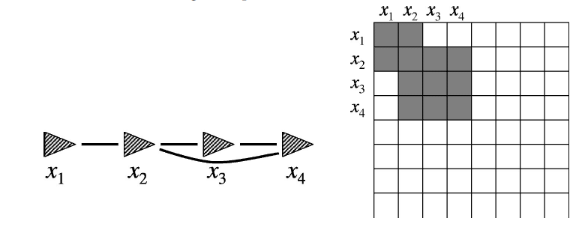
Reducing the dependence graph
The final result:
The resulting information matrix is much smaller. This reduction can be done in time linear in size N

Slide 12
Updating the full state estimate from the path
There is now an estimate of the path robot
This requires to solve a system of linear equations, which is not linear in size t due to cycles (loop closures!).
When found, the map can be recovered. For each landmark m_{j}:
In addition, an estimate of the covariance Σ_{0:t} over the robot path is known (but not over the full state y)

Slide 13
Full Algorithm
The previous steps should be iterated to get a reliable state estimate μ:

Slide 14
Full Algorithm
The algorithm can be extended for unknown correspondences:

Slide 15
Correspondence test
Based on the probability that m_{j} corresponds to m_{k}:

Slide 16
GroundHog in abandoned mine
Correspondences are discovered:
Sebastian Thrun et al., Autonomous Exploration and Mapping of Abandoned Mines, IEEE Robotics and Automation Magazine 11(4), 2005.

Slide 17
GroundHog in abandoned mine
Correspondences are propagated and dissolved:

Slide 18
GroundHog in abandoned mine
Iterations stops when data associations induce no further changes:

Slide 19
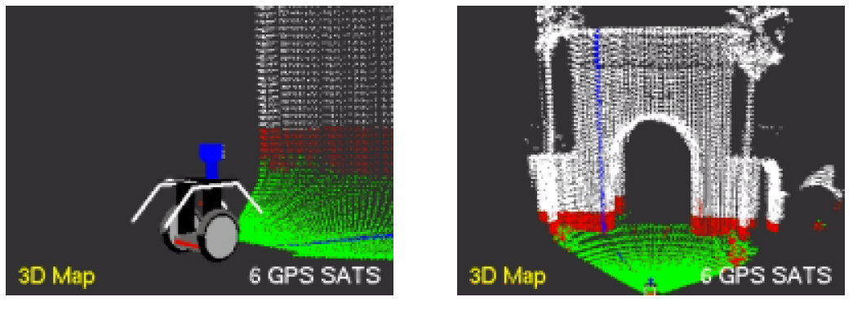
Segway RMP at Stanford
Segway with vertically mounted laserscanner:
Green is ground, red obstacles, white structures above the robot
Sebastian Thrun and Micheal Montemerlo, The Graph SLAM Algorithm with Applications to Large-Scale Mapping of Urban Structures, International Journal on Robotics Research 25(5/6), p. 403-430, 2005

Slide 20
Segway RMP at Stanford
3D map of the Stanford campus:

Slide 21
Segway RMP at Stanford
Color coded 3D map of the Stanford campus:

Slide 22
Segway RMP at Stanford
Top view of 3D map of the Stanford campus:

Slide 23
Segway RMP at Stanford
Effect of GPS on indoor mapping:

Slide 24
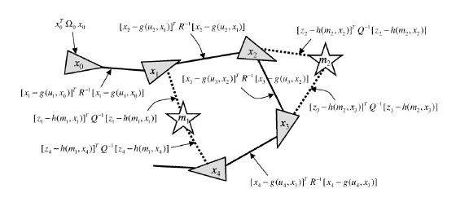
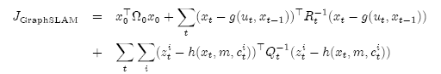
Resumé
Use a graph to represent the problem:
Every node in the graph corresponds to a pose or an observation of the robot during mapping
Every edge between two nodes corresponds to the spatial constraints between them

Slide 25
Conclusion
GraphSLAM:
Solves the Full SLAM problem as post-processing step
Creates a graph of soft constraints from the data-set
By minimizing the sum of all constraints the maximum likelihood estimate of both the map and the robot path is found
The algorithm works in iterating three steps: construction, reduction, solving remaining equations

